Slide 1
Attribute Evaluation
—— 2016/6
下午 11:15
79

Slide 2
Outline
Introduction
The Architecture Tradeoff Analysis Method (ATAM) Evaluation
The Cost Benefit Analysis Method (CBAM) Evaluation
下午 11:15
79

Slide 3
Outline of Introduction
Role of Evaluation
Evaluation Factor (who)
Contextual Factor (what)
下午 11:15
79

Slide 4
1. Role of Evaluation
Role of evaluation: Architecture is such an important contributor to the success of a system that it makes sense to pause and make sure that the architecture will be able to provide all that’s expected of it
Analysis lies at the heart of architecture evaluation, which is the process of determining if an architecture is fit for the purpose for which it is intended
下午 11:15
79

Slide 5
2. Evaluation Factors
Evaluation usually takes one of three forms:
Evaluation by the designer within the design process
Evaluation by peers within the design process
Analysis by outsiders once the architecture has been designed
下午 11:15
79

Slide 6
2.1 Evaluation by the Designer
Every time the designer makes a key design decision or completes a design milestone, the chosen and competing alternatives should be evaluated
Evaluation by the designer is the test part of the generate-and-test approach
How much analysis? This depends on the importance of the decision
下午 11:15
79

Slide 7
2.1.1 Some Specific Considerations by designer
The importance of the decision
The number of potential alternatives. The more alternatives, the more time could be spent in evaluating them
Good enough as opposed to perfect. Do not spend more time on a decision than it is worth
下午 11:15
79

Slide 8
2.2 Peer Review
A peer review can be carried out at any point of the design process where a candidate architecture, or at least a coherent reviewable part of one, exists
There should be a fixed amount of time allocated for the peer review, at least several hours and possibly half a day
下午 11:15
79

Slide 9
2.2.1 Steps of a Peer Review
The reviewers determine a number of quality attribute scenarios to drive the review
The architect presents the portion of the architecture to be evaluated
The reviewers access that for each scenario is satisfied
Potential problems are captured when reviewed
下午 11:15
79

Slide 10
2.3 Analysis by Outsiders
Outside evaluators can cast an objective eye on an architecture
Outside is relative:
Outside the development project
Outside the business unit where the project resides but within the same company
Outside the company
下午 11:15
79

Slide 11
2.3.1 Chosen Outsiders
Outsiders are chosen because they possess specialized knowledge or experience
Knowledge about a quality attribute that’s important to the system being examined
Experience in successfully evaluating architectures
下午 11:15
79

Slide 12
2.3.2 What Does Outsiders Evaluation
In principle, an outsider team may evaluate a completed architecture, an incomplete architecture, or a portion of an architecture
In practice, they tend to be used to evaluate complete architectures
下午 11:15
79

Slide 13
3. Contextual Factors
For peer reviews or outside analysis, there are a number of contextual factors that must be considered
Artifacts available
Whether the results are public or private
The number and skill of evaluator
The number and identity of the stakeholders
How the business goal are understood
下午 11:15
79

Slide 14
Outline of ATAM
Introduction of ATAM
Participants in the ATAM
Outputs of the ATAM
Phases of the ATAM
下午 11:15
79

Slide 15
1. Introduction of ATAM Architecture Evaluation
Architecture Tradeoff Analysis Method (ATAM) has been used for over a decade to evaluate software architectures in domains ranging from automotive to financial to defense
ATAM reveals how well an architecture satisfies particular quality goals, and it provides insight into how quality goals interact—that is, how they trade off
下午 11:15
79

Slide 16

2. Participants in the ATAM
The ATAM requires the participation and mutual cooperation of three groups:
The evaluation team
Project decision makers
Architecture stakeholders
下午 11:15
79

Slide 17
2.1 The evaluation team
The evaluation team is:
This group is external to the project whose architecture is being evaluated
It usually consists of three to five people. Each member of the team is assigned a number of specific roles to play during the evaluation
In any case, they need to be recognized as competent, unbiased outsiders
下午 11:15
79

Slide 18
2.1.1 The Role of the Evaluation Team
The evaluation team include below roles：
Team Leader
Evaluation Leader
Scenario Scribe
Proceedings Scribe
Questioner
下午 11:15
79

Slide 19
2.1.1.1 Important Team Roles
No | Role | Responsibilities | Desirable characteristics
1 | Team Leader | Sets up the evaluation; coordinates with client, establishes evaluation contract; forms evaluation team; release final report | Well-organized, with managerial skills
2 | Evaluation Leader | Runs evaluation; facilitates elicitation of scenarios; administers scenario selection/prioritization process; facilitates evaluation of scenarios against architecture; facilitates onsite analysis | Comfortable in front of audience; excellent facilitation skills; good understanding of architectural issues; practiced in architecture evaluations;
下午 11:15
79

Slide 20
2.2.2 Project Decision Makers
Project decision makers are:
Empowered to speak for the development project or have the authority to mandate changes to it
The architect is always included—a cardinal rule of architecture evaluation is that the architect must willingly participate
下午 11:15
79

Slide 21

2.2.3 Architecture Stakeholders
Architecture stakeholders have a vested interest in the architecture performing as advertised. Stakeholders include:
developers, testers
integrators
maintainers
performance engineers
users
builders of systems interacting with the one under consideration, and others
下午 11:15
79

Slide 22

2. Outputs of the ATAM
An ATAM-based evaluation will produce at least the following outputs:
A concise presentation of the architecture
Articulation of the business goals
Prioritized quality attribute requirements expressed as quality attribute scenarios
下午 11:15
79

Slide 23
2.1 Outputs of the ATAM(1)
A set of risks and nonrisks
A set of risk themes
Mapping of architectural decisions to quality requirements
A set of identified sensitivity and tradeoff points
下午 11:15
79

Slide 24
2.2 Glossary About ATAM
Sensitivity ——Architectural decisions that have a marked effect on one quality attribute
Tradeoff points ——Architectural decisions that have a marked effect on more quality attributes
Risks ——A risk is an architectural decision that may lead to undesirable consequences in light of stated quality attribute requirements
Nonrisks ——an architectural decision that, upon analysis, is deemed safe
下午 11:15
79

Slide 25
3 Phases of the ATAM
Activities in an ATAM-based evaluation are spread out over four phases
Partnership and preparation
Evaluation 1
Evaluation2 (continued)
Follow-up
下午 11:15
79

Slide 26
3.1 ATAM Phases and Their Characteristics
Pha-se | Activity | Participants | Typical Duration
1 | Partnership and preparation | Evaluation team leadership and key project decision makers | Proceeds informally as required, perhaps over a few weeks
2 | Evaluation1 | Evaluation team and project decision makers | 1 -2days followed by a hiatus of 1 to 3 weeks
3 | Evaluation2 (continued) | Evaluation team, project decision makers, and stakeholders | 2 days
4 | Follow-up | Evaluation team and evaluation client | 1 week
下午 11:15
79

Slide 27

3.2 Partnership and preparation(1)
In phase 0, the evaluation team leadership and the key project decision makers informally meet to work out the details of the exercise:
The project representatives brief the evaluators about the project
Together, the two groups agree on logistics, such as the time and place of meetings
下午 11:15
79

Slide 28
3.2.1 Partnership and preparation(2)
They also agree on a preliminary list of stakeholders
They work out delivery to the evaluation team of whatever architectural documentation exists and may be useful
The evaluation team leader explains what information the manager and architect will be expected to show during phase 1
下午 11:15
79

Slide 29
3.3 ATAM Evaluation
Phase 1 and phase 2 are the evaluation phases, where everyone gets down to the business of analysis
Present the ATAM
Present Business Drivers
Present Architecture
Identify Architectural Approaches
Generate Quality Attribute Utility Tree
Analyze Architectural Approaches
Brainstorm and Prioritize Scenarios
Analyze Architectural Approaches
Present Results
下午 11:15
79

Slide 30
3.3.1 Present the ATAM
The first step calls for the evaluation leader to present the ATAM to the assembled project representatives
This time is used to explain the process that everyone will be following
Using a standard presentation, the leader will describe the ATAM steps in brief and the outputs of the evaluation
下午 11:15
79

Slide 31
3.3.2 Present Business Drivers
Understand the context for the system and the primary business drivers motivating its development ：
The system's most important functions
Any relevant technical, managerial, economic, or political constraints
The business goals and context as they relate to the project
The major stakeholders
The architectural drivers
下午 11:15
79

Slide 32

3.3.3 Present Architecture
The lead architect makes a presentation describing the architecture at an appropriate level of detail:
How much of the architecture has been designed and documented
How much time is available
The nature of the behavioral and quality requirements
下午 11:15
79

Slide 33
3.3.3.1 Present Architecture(1)
Architecture Presentation (20 slides; 60 minutes):
Driving architectural requirements (2–3 slides)
Important Architectural Information (4–8 slides)
  Context diagram
  Module or layer view
  Component-and-connector view
  Deployment view
下午 11:15
79

Slide 34
3.3.3.2 Content of architecture
Architectural approaches, patterns, or tactics employed (3–6 slides)
  Use of commercial off-the-shelf (COTS) products and how they are chosen/integrated
  Trace of 1 to 3 of the most important use case scenarios(1–3 slides)
  Trace of 1 to 3 of the most important change scenarios(1–3 slides)
  Architectural issues/risks with respect to meeting the driving architectural requirements (2–3 slides)
  Glossary (1 slide)
下午 11:15
79

Slide 35
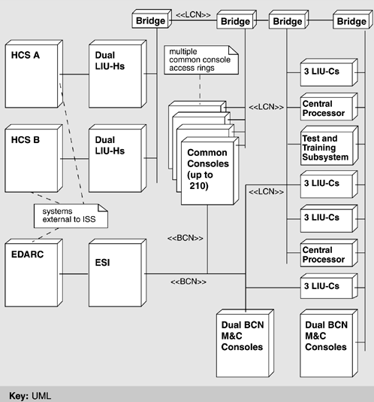
3.3.2.3 Example of Architecture Presentation
下午 11:15
79

Slide 36
3.3.4 Identify Architectural Approaches
The ATAM focuses on analyzing an architecture by understanding its architectural approaches
The evaluation team will have a good idea of what patterns and approaches the architect used in designing the system
In this short step, the evaluation team simply catalogs the patterns and approaches that are evident
下午 11:15
79

Slide 37
3.3.5 Generate Quality Attribute Utility Tree
In this step, the quality attribute goals are articulated in detail via a mechanism known as the utility tree
The utility tree serves to make the requirements concrete
Evaluation team works with the project decision makers to identify, prioritize, and refine the system's most important quality attribute goals, which are expressed as scenarios
下午 11:15
79

Slide 38
3.3.5.1 Quality Attribute Utility Tree
Utility as the root node. Utility is an expression of the overall "goodness" of the system
Quality attributes form the middle level
Scenarios form the leaves of the utility tree
utility
…
availability
performance
usability
Frequency
Enhance..
…
Scenario1
Scenario2
…
Quality Attribute Utility Tree
下午 11:15
79

Slide 39
3.3.5.2 prioritize scenarios
Scenarios that are the most important prioritize (H，M，L) and difficult prioritize (H，M，L) too.
Now each scenario has an associated ordered pair: (H,H), (H,M), (H,L), and so forth
We care the (H, H) (H,M) or (M, H)
下午 11:15
79

Slide 40
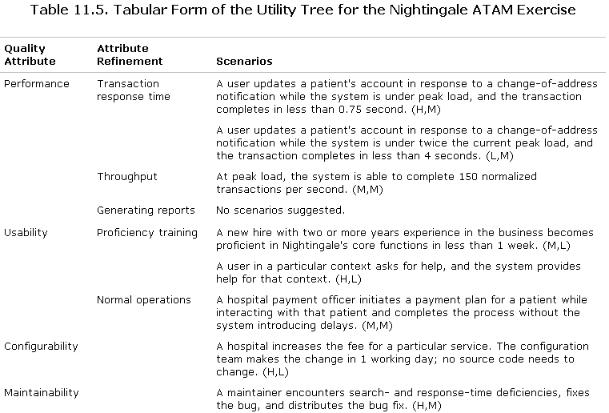
3.3.5.3 Nightingale Quality Attribute Utility Tree
下午 11:15
79

Slide 41
3.3.5.4 Agenda for Day 1 of the ATAM
Time | Activity
08:30 ~ 10:00 | Introductions; Step1: Present the ATAM
10:00 ~ 11:00 | Step2: Present Business Drivers
11:00 ~ 11:30 | Break
11:30 ~ 12:30 | Step3: Present Architecture
12:30 ~ 13:30 | Lunch
13:30 ~ 14:30 | Step4: Identify Architectural Approaches
14:30 ~ 15:30 | Step5: Generate Utility Tree
15:30 ~ 16:00 | Break
16:00 ~ 17:00 | Step5: Generate Utility Tree(continued)
下午 11:15
79

Slide 42
3.3.6 Analyze Architectural Approaches
The evaluation team examines the highest-ranked scenarios one at a time:
the architect is asked to explain how the architecture supports each one
Questioners probe for the architectural approaches that the architect used to carry out the scenario
下午 11:15
79

Slide 43
3.3.6 Analyze Architectural Approaches
Documents the relevant architectural decisions and identifies and catalogs their risks, nonrisks, sensitivity points, and tradeoffs
The scenario walkthrough leads to a discussion of possible risks, nonrisks, sensitivity points, or tradeoff points
下午 11:15
79

Slide 44
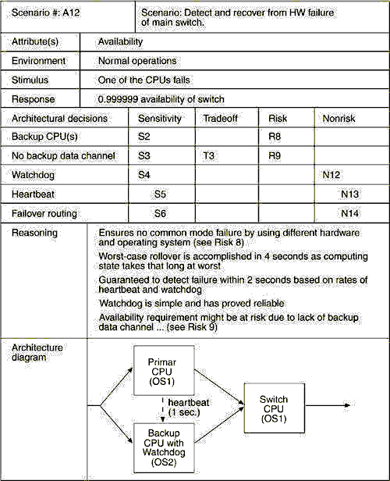
下午 11:15
79

Slide 45
3.4 Brainstorm and Prioritize Scenarios
The purpose of scenario brainstorming is to take the pulse of the larger stakeholder community
In this step, the evaluation team asks the stakeholders to brainstorm scenarios that are operationally meaningful with respect to the stakeholders' individual roles
下午 11:15
79

Slide 46
3.4.1 Prioritize Scenarios
Once the scenarios have been collected, they must be prioritized
First, stakeholders are asked to merge scenarios they feel represent the same behavior or quality concern
Then they vote for those they feel are most important
下午 11:15
79

Slide 47
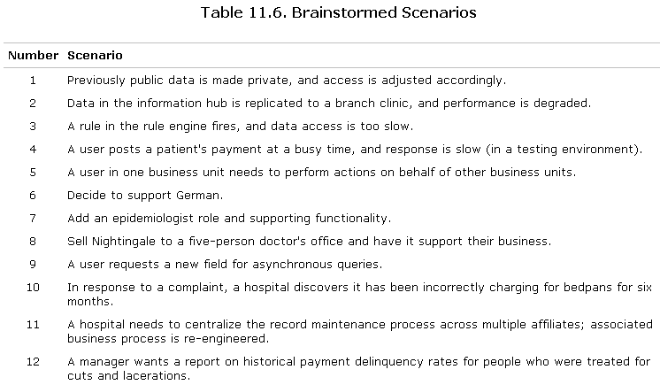
3.4.1 Nightingale Brainstorm and Prioritize Scenarios
下午 11:15
79

Slide 48
3.4.2 Analyze Architectural Approaches
After the scenarios have been collected and prioritized, the evaluation team guides the architect in the process of carrying out the highest ranked scenarios from step 7
The architect explains how relevant architectural decisions contribute to realizing each one
下午 11:15
79

Slide 49
3.4.3 Present Results
Finally, the collected information to be summarized and presented once again to stakeholders：
The architectural approaches documented
The set of scenarios and their prioritization from the brainstorming
The utility tree
The risks discovered
The nonrisks documented
The sensitivity points and tradeoff points found
下午 11:15
79

Slide 50
3.4.4 Summary of ATAM Evaluation step
Present the ATAM
Present Business Drivers
Present Architecture
Identify Architectural Approaches
Generate Quality Attribute Utility Tree
Analyze Architectural Approaches
Brainstorm and Prioritize Scenarios
Analyze Architectural Approaches
Present Results
下午 11:15
79

Slide 51
3.5 Follow-up(1)
Phase 4 is follow-up in which the evaluation team produces and delivers a written final report
The essence of this phase, however, is team self-examination and improvement
During a post-mortem meeting, the team discusses what went well and what didn't
下午 11:15
79

Slide 52
3.5.1 follow-up(2)
Team members look for improvements in how they carry out their functions so that the next evaluation can be smoother or more effective
The team catalogs how much effort was spent during the evaluation, on the part of each of the three participating groups
After an appropriate number of months, the team leader contacts the evaluation client to gauge the long-term effects of the exercise so that costs and benefits can be compared
下午 11:15
79

Slide 53
3.6 ATAM is not support
In addition to understanding what the ATAM is, it is also important to understand what it is not
The ATAM is not an evaluation of requirements
The ATAM is not a code evaluation
The ATAM does not include actual system testing
The ATAM is not a precise instrument, but identifies possible areas of risk within the architecture. These risks are embodied in the sensitivity points and the tradeoffs
下午 11:15
79

Slide 54
3.6 ATAM is not support
In addition to understanding what the ATAM is, it is also important to understand what it is not
The ATAM is not an evaluation of requirements
The ATAM is not a code evaluation
The ATAM does not include actual system testing
The ATAM is not a precise instrument, but identifies possible areas of risk within the architecture. These risks are embodied in the sensitivity points and the tradeoffs
下午 11:15
79

Slide 55
3.7 Lightweight Architecture Evaluation
ATAM requires some 20 to 30 person-days of effort from an evaluation team, plus even more for the architect and stakeholders
Investing this amount of time only makes sense on a large and costly project
A lightweight architecture evaluation (LAE) exercise may take place in a single day for smaller, less risky projects
下午 11:15
79

Slide 56
3.7.1 A Typical Agenda for LAE
Present the ATAM (0 hrs)
Present Business Drivers (0.25 hrs)
Present Architecture (0.5 hrs)
Identify Architectural Approaches (0.25 hrs)
Generate Quality Attribute Utility Tree ( Variable 0.5hrs – 1.5 hrs)
Analyze Architectural Approaches (2-3 hrs)
Brainstorm and Prioritize Scenarios (0 hrs)
Analyze Architectural Approaches (0 hrs)
Present Results (0.5 hrs)
下午 11:15
79

Slide 57
Outline of CBAM
CBAM Approach Introduction
The Relation between ATAM and CBAM Approach
The Basis of CBAM Approach
The Step of CBAM Approach
下午 11:15
79

Slide 58
1. CBAM Approach Introduction
The biggest tradeoffs in large, complex systems usually have to do with economics
How should an organization invest its resources to maximize gain and minimize risk?
Economics includes cost to build
Benefits are an architecture delivers
下午 11:15
79

Slide 59
1.1 The Concept of CBAM
CBAM(Cost Benefit Analysis Method ) is a method of economic modeling of software systems, centered on an analysis of their architectures
It provides an assessment of the technical and economic issues and architectural decisions
下午 11:15
79

Slide 60
1.2 Decision-Making Context
The software architect or decision maker wishes to maximize the difference between the benefit derived from the system and the cost of implementing the design
Performance
Business
Goals
Architecture
Strategies
Modifiability
Benefit
Security
Usability
Cost
…
Context for the CBAM
下午 11:15
79

Slide 61

1.3 The Example of Economic Evaluation
Steve.Jobs and John.Sculley
下午 11:15
79

Slide 62
2. The Relation between ATAM and CBAM Approach
The difference of ATAM and CBAM
The Destination is different
The ATAM cares product itself, it provides software architects a means of evaluating the technical tradeoffs
The CBAM cares economics, It takes into account costs, benefits, risks, and schedule implications
下午 11:15
79

Slide 63
2.1 The difference of ATAM and CBAM
The Stage is different
ATAM ——〉CBAM
The CBAM begins where the ATAM concludes and, in fact, depends upon the artifacts that the ATAM produces as output
下午 11:15
79

Slide 64
2.2 The Link of ATAM and CBAM
The ATAM identifies the set of key architectural decisions relevant to the quality attribute scenarios elicited from the business goal
The CBAM takes into account directly the cost and benefit of the business goal
ATAM
Business goal
CBAM
Base on
Base on
Quality attributes scenarios
下午 11:15
79

Slide 65
2.3 The Technology Impact on the Cost
The stakeholders decide if they should:
  Use redundant hardware; failover; load balance
  Save cost on this project, invest in another, for example: redundant software
下午 11:15
79

Slide 66
3. The Basis of CBAM Approach
The idea behind the CBAM is that architectural strategies affect the quality attributes and these in turn provide stakeholders with some benefit
The CBAM can aid the stakeholders in choosing architectural strategies based on their value for cost (VFC)
VFC = benefit / cost
下午 11:15
79

Slide 67
3.1 Utility
We refer to benefit as utility. Each architectural strategy provides a specific level of utility to the stakeholders
Utility is the benefit gained by system stakeholders
The utility is based on the importance of each scenario being considered with respect to its anticipated response value
下午 11:15
79

Slide 68
3.1 Utility-Response Curves
CBAM structure scenarios into three parts: stimulus (an interaction with the system), environment (the system's state at the time), and response (the measurable quality attribute that results)
The CBAM actually uses a set of scenarios (generated by varying the values of the responses) rather than individual scenarios as in the ATAM. This leads to the concept of a utility-response curve
下午 11:15
79

Slide 69
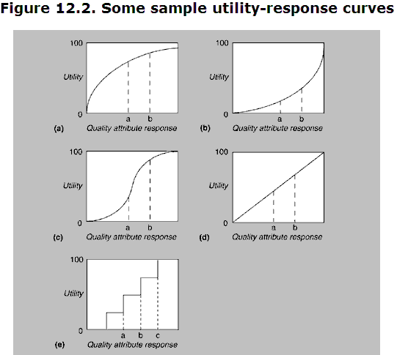
3.1.1 Various Utility-Response Curves
We can portray each relationship between a set of utility measures and a corresponding set of response measures as a graph—a utility-response curve
下午 11:15
79

Slide 70
3.1.2 Special Points On the URC
4 values independent of architectural strategy
  Best-case (0.1 sec RT is instantaneous to a person, so 0.03 doesn’t matter) = 100
  Worst-case (minimum requirement) = 0
  Current (relative to Best & Worst) = x%
  Desired (relative to Best & Worst) = y%
Generate the curves for all scenarios
下午 11:15
79

Slide 71
3.2 Priorities of Scenarios
Different scenarios have different levels of importance
To characterize the relative importance of each scenario, a weight is assigned through a two-step voting exercise
Stakeholders vote on the scenarios to establish an ordering among them
The stakeholders then assign a weight of 1 to the highest-rated scenario and a fractional amount to the other scenarios
下午 11:15
79

Slide 72
3.3 Architectural Strategies
Architects, to determine the architectural strategies for moving from the current quality attribute response level to the desired level
For each strategy, we can derive:
The expected value of the response in each scenario
The effect of the architectural strategy on other attributes of interest
A cost estimate for implementing the architectural strategy
下午 11:15
79

Slide 73
3.4 Determining benefit and normalization
We calculate the overall utility of an architectural strategy across scenarios, For each architectural strategy, we calculate a benefit Bi as follows:
B_{i} =∑(b_{i,j} × W_{j})
b_{i,j} = U_{expected}-U_{current}
Where b_{i,j} is the benefit accrued to strategy i due to its effect on scenario j and W_{j} is the weight of scenario j.
下午 11:15
79

Slide 74
3.5 Calculating VFC
The VFC value for each architectural strategy is the ratio of the total benefit, Bi to the Cost Ci of implementing it.
VFC_{i} = B_{i} / C_{i}
Using this VFC score, the architectural strategies can be rank-ordered; this rank ordering can then be used to determine the optimal order for implementation of the various strategies
下午 11:15
79

Slide 75
3.6 Choose Architectural strategy Based on VFC
Strategy | Cost | Total Benefit | Strategy VFC | Strategy Rank
1 | 1000 | 780 | 78% | 1
2 | 400 | 120 | 30% | 3
3 | 200 | 80 | 40% | 2
Table VFC of Architectural Strategies
下午 11:15
79

Slide 76
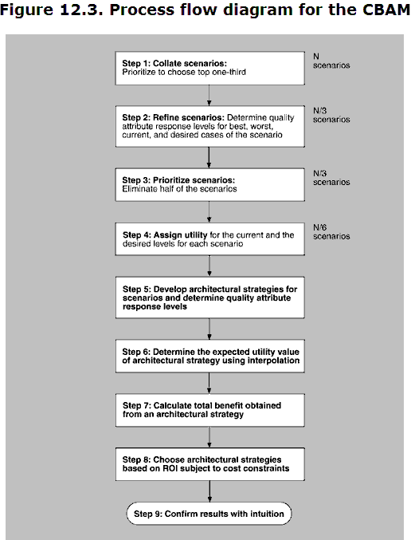
4. The Step of the CBAM
The total nine steps for implementing the CBAM
下午 11:15
79

Slide 77
Summary
The architecture evaluation is important
There are two evaluation method
The ATAM
The CBAM
下午 11:15
79

Slide 78
Homework
Think of a software system that you’re working on. Prepare a 30 minute presentation on the business drivers for this system
下午 11:15
79

Slide 79
Discuss
What is the important base for the architecture evaluation? How do you evaluate your architecture?
(Reference chapter 14)
下午 11:15
79

